Slide 1


College Physics
Chapter 17 PHYSICS OF HEARING
PowerPoint Image Slideshow

Slide 2
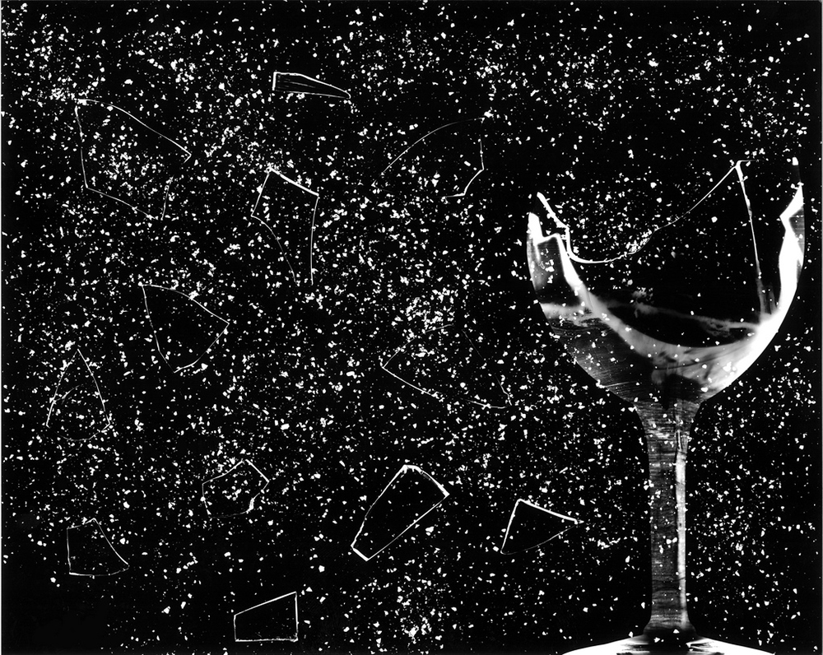
Figure 17.2
This glass has been shattered by a high-intensity sound wave of the same frequency as the resonant frequency of the glass. While the sound is not visible, the effects of the sound prove its existence.

Slide 3
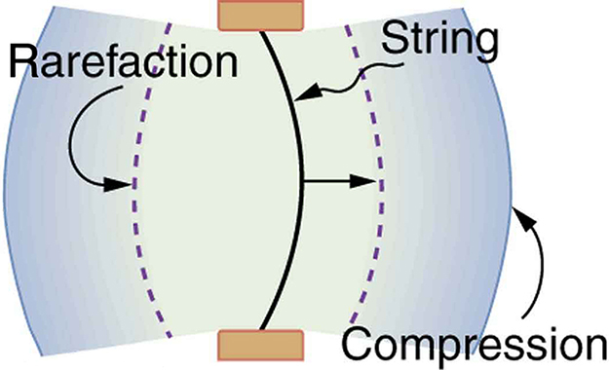
A vibrating string moving to the right compresses the air in front of it and expands the air behind it.
Sound is a familiar illustration of waves. Because hearing is one of our most important senses, it is interesting to see how the physical properties of sound correspond to our perceptions of it. Hearing is the perception of sound, just as vision is the perception of visible light. But sound has important applications beyond hearing. Ultrasound, for example, is not heard but can be employed to form medical images and is also used in treatment.

Slide 4
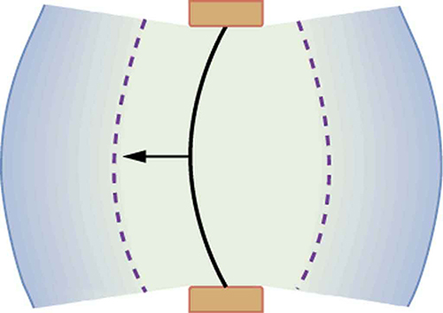
As the string moves to the left, it creates another compression and rarefaction as the ones on the right move away from the string.
The sound is defined to be a disturbance of matter that is transmitted from its source outward. Sound is a wave. On the atomic scale, it is a disturbance of atoms that is far more ordered than their thermal motions. In many instances, sound is a periodic wave, and the atoms undergo simple harmonic motion. In this text, we shall explore such periodic sound waves.

Slide 5
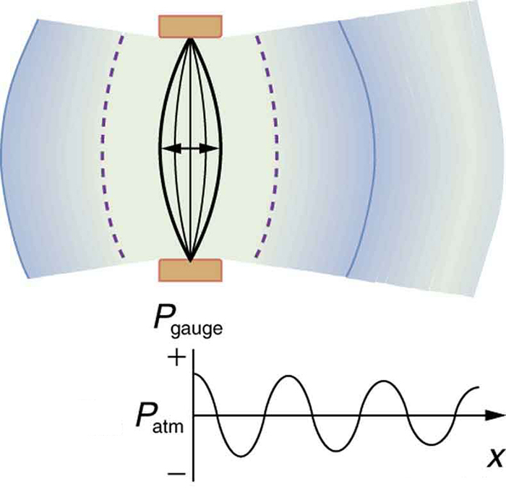
After many vibrations, there are a series of compressions and rarefactions moving out from the string as a sound wave. The graph shows gauge pressure versus distance from the source. Pressures vary only slightly from atmospheric for ordinary sounds.
These compressions (high pressure regions) and rarefactions (low pressure regions) move out as longitudinal pressure waves having the same frequency as the string—they are the disturbance that is a sound wave.

Slide 6
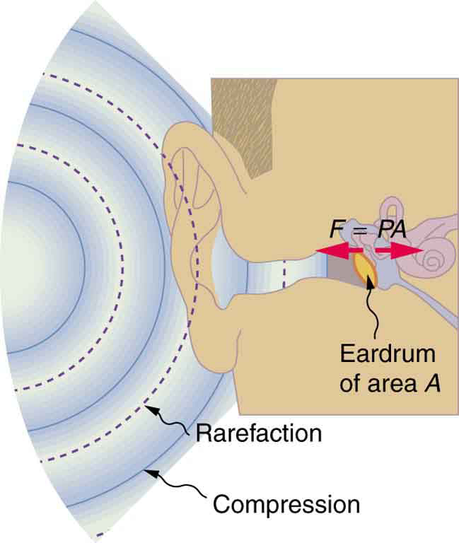
Sound wave compressions and rarefactions travel up the ear canal and force the eardrum to vibrate. There is a net force on the eardrum, since the sound wave pressures differ from the atmospheric pressure found behind the eardrum. A complicated mechanism converts the vibrations to nerve impulses, which are perceived by the person.
The amplitude of a sound wave decreases with distance from its source, because the energy of the wave is spread over a larger and larger area. But it is also absorbed by objects, such as the eardrum in Figure, and converted to thermal energy by the
viscosity of air. In addition, during each compression a little heat transfers to the air and during each rarefaction even less heat transfers from the air, so that the heat transfer reduces the organized disturbance into random thermal motions. Whether the heat transfer from compression to rarefaction is significant depends on how far apart they are—that is, it depends on wavelength.

Slide 7

When a firework explodes, the light energy is perceived before the sound energy. Sound travels more slowly than light does.
The flash of an explosion is seen well before its sound is heard, implying both that sound travels at a finite speed and that it is much slower than light. You can also directly sense the frequency of a sound. Perception of frequency is called pitch. A small instrument creates short-wavelength sounds (a piccolo, high pitch). Similar arguments hold that a large instrument creates long-wavelength sounds (a tuba, low pitch). The relationship of the speed of sound, its frequency, and wavelength is the same as for all waves:
v_{w} = f λ
where v_{w} is the speed of sound, f is its frequency, and λ is its wavelength. The wavelength of a sound is the distance between adjacent identical parts of a wave—for example, between adjacent compressions. The frequency is the same as that of the source and is the number of waves that pass a point per unit time.

Slide 8
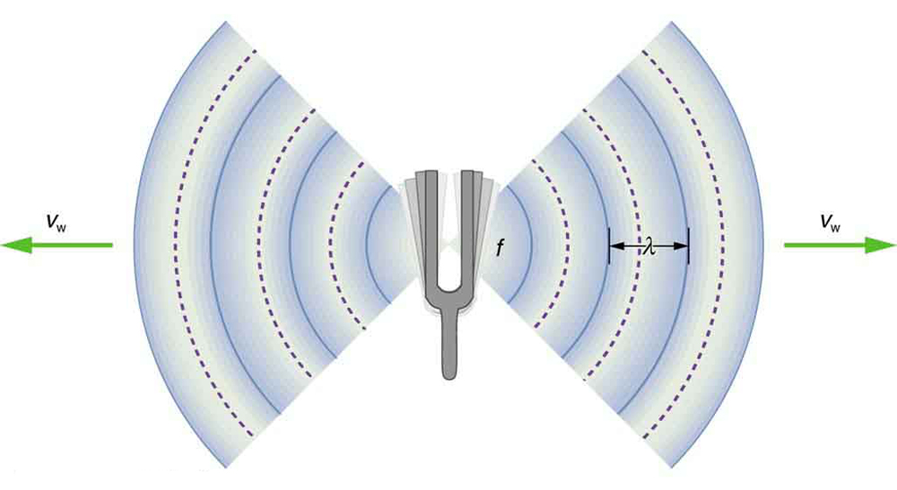
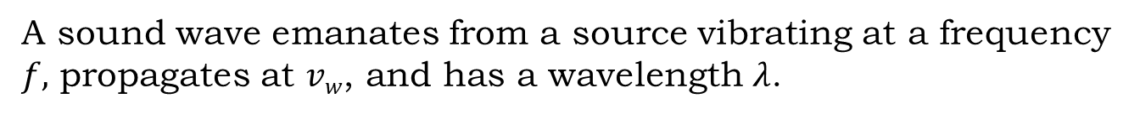
A sound wave emanates from a source vibrating at a frequency $f,$ propagates at $vw$, and has a wavelength $λ$.

Slide 9
Medium v_{w}(m/s)
Gases at 0ºC
Air 331
Carbon dioxide 259
Oxygen 316
Helium 965
Hydrogen 1290
Liquids at 20ºC
Ethanol 1160
Mercury 1450
Water, fresh 1480
Sea water 1540
Human tissue 1540
Solids (longitudinal or bulk)
Vulcanized rubber 54
Polyethylene 920
Marble 3810
Glass, Pyrex 5640
Lead 1960
Aluminum 5120
Steel 5960
The speed of sound in a medium is determined by a combination of the medium’s rigidity (or compressibility in gases) and its density. The more rigid (or less
compressible) the medium, the faster the speed of sound. This observation is analogous to the fact that the frequency of a simple harmonic motion is directly proportional to the stiffness of the oscillating object. The greater the density of a medium, the slower the speed of sound. This observation is analogous to the fact that the frequency of a simple harmonic motion is inversely proportional to the mass of the oscillating object. The speed of sound in air is low, because air is compressible. Because liquids and solids are relatively rigid and very difficult to compress, the speed of sound in such media is generally greater than in gases.

Slide 10
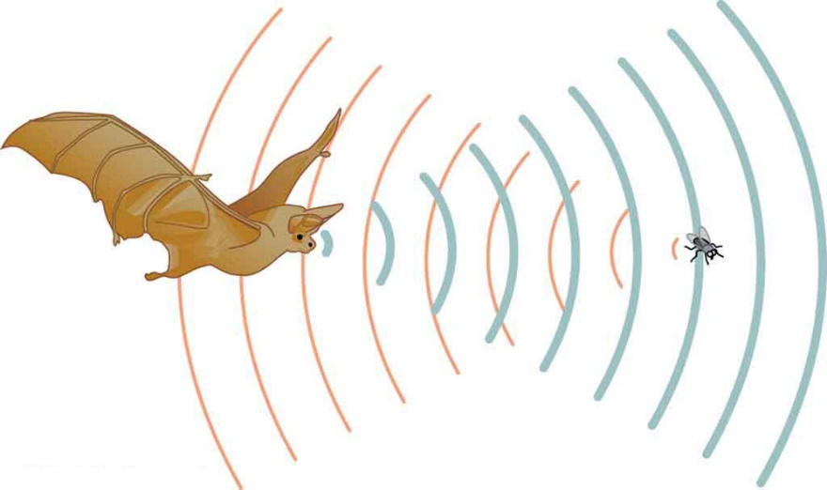
A bat uses sound echoes to find its way about and to catch prey. The time for the echo to return is directly proportional to the distance.
The speed of sound is affected by temperature in a given medium. For air at sea level, the speed of sound is given by
v_{w} = (331 m/s) (T/273 K)^{1/2}
where the temperature (denoted as T) is in units of kelvin. The speed of sound in gases is related to the average speed of particles in the gas, v_{rms}, and that
v_{rms} = (3kT/m)^{1/2}
where k is the Boltzmann constant (1.38×10⁻²³ J/K) and m is the mass of each (identical) particle in the gas. So, it is reasonable that the speed of sound in air and other gases should depend on the square root of temperature. While not
negligible, this is not a strong dependence. At 0ºC , the speed of sound is 331 m/s, whereas at 20.0ºC it is 343 m/s, less than a 4% increase. Figure shows a use of the speed of sound by a bat to sense distances. Echoes are also used in medical imaging.

Slide 11
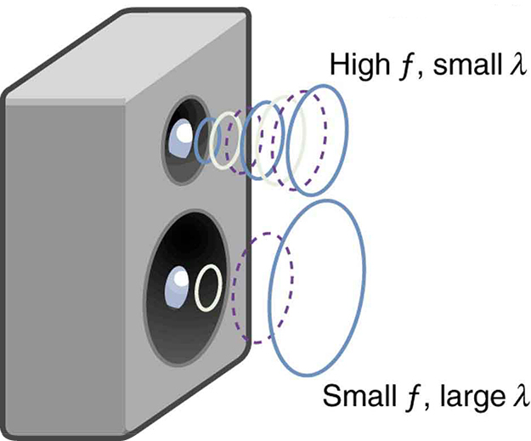
Because they travel at the same speed in a given medium, low-frequency sounds must have a greater wavelength than high-frequency sounds. Here, the lower frequency sounds are emitted by the large speaker, called a woofer, while the higher-frequency sounds are emitted by the small speaker, called a tweeter.
One of the more important properties of sound is that its speed is nearly independent of frequency. This independence is certainly true in open air for sounds in the audible range of 20 to 20,000 Hz. If this independence were not true, you would certainly notice it for music played by a marching band in a football stadium, for example. Suppose that high-frequency sounds traveled faster—then the farther you were from the band, the more the sound from the low-pitch instruments would lag that from the high-pitch ones. But the music from all instruments arrives in cadence independent of distance, and so all frequencies must travel at nearly the same speed.

Slide 12
What Are the Wavelengths of Audible Sounds?
Calculate the wavelengths of sounds at the extremes of the audible range, 20 and 20,000 Hz, in 30.0ºC air.
To find wavelength from frequency, we can use v_{w} = f λ.
1. Identify knowns. The value for v_{w}, is given by
v_{w} = (331 m/s) (T/273 K)^{1/2}.
2. Convert the temperature into kelvin and then enter the temperature into the equation
v_{w} = (331 m/s) (303 K/273 K)^{1/2} = 348.7 m/s.
3. Solve the relationship between speed and wavelength for λ:
λ = v_{w} /f .
4. Enter the speed and the minimum frequency to give the maximum wavelength:
λ_{max} = 348.7 m/s/20 Hz = 17 m.
5. Enter the speed and the maximum frequency to give the minimum wavelength:
λ_{min} = 348.7 m/s/20,000 Hz = 0.017 m = 1.7 cm.
Because the product of f multiplied by λ equals a constant, the smaller f is, the larger λ must be, and vice versa. The speed of sound can change when sound travels from one medium to another. However, the frequency usually remains the same because it is like a driven oscillation and has the frequency of the original source. If v_{w} changes and f remains the same, then the wavelength λ must change. That is, because v_{w} = f λ , the higher the speed of a sound, the greater its wavelength for a given frequency.

Slide 13
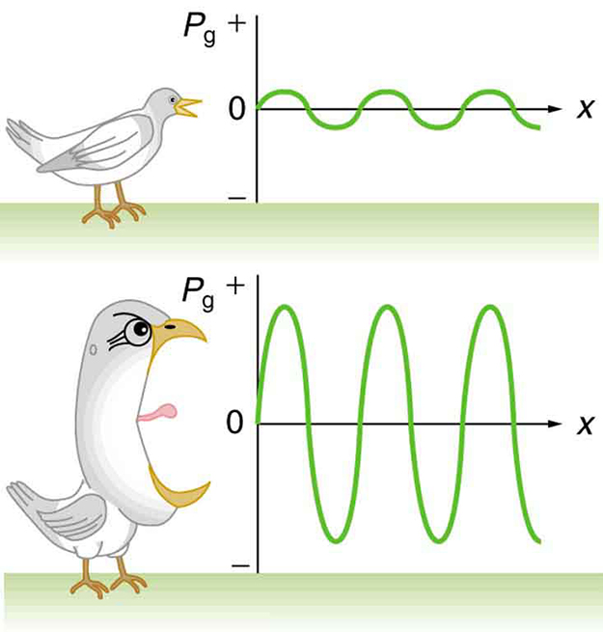
The loudness of sounds
Graphs of the gauge pressures in two sound waves of different intensities. The more intense sound is produced by a source that has larger-amplitude oscillations and has greater pressure maxima and minima. Because pressures are higher in the greater-intensity sound, it can exert larger forces on the objects it encounters.

Slide 14
Intensity is defined to be the power per unit area carried by a wave. Power is the rate at which energy is transferred by the wave. In equation form, intensity I is
I = P/A
where P is the power through an area A . The SI unit for I is W/m². The intensity of a sound wave is related to its amplitude squared by the following relationship
I = (Δp)²/2ρvw
Here Δp is the pressure variation or pressure amplitude (half the difference between the maximum and minimum pressure in the sound wave) in units of pascals (Pa) or N/m² . (We are using a lower case p for pressure to distinguish it from power, denoted by P above) The energy (as kinetic energy mv²/2) of an oscillating element of air due to a traveling sound wave is proportional to its amplitude squared. In this equation, ρ is the density of the material in which the sound wave travels, in units of kg/m³ , and v_{w} is the speed of sound in the medium, in units of m/s. The pressure variation is proportional to the amplitude of the oscillation, and so I varies as (Δp)². This relationship is consistent with the fact that the sound wave is produced by some vibration; the greater its pressure amplitude, the more the air is compressed in the sound it creates.
:

Slide 15
Sound intensity levels are quoted in decibels (dB) much more often than sound intensities in watts per meter squared. Decibels are the unit of choice in the scientific literature as well as in the popular media. The reasons for this choice of units are related to how we perceive sounds. How our ears perceive sound can be more accurately described by the logarithm of the intensity rather than directly to the intensity. The sound intensity level β in decibels of a sound having an intensity I in watts per meter squared is defined to be
β(dB) = 10 log₁₀ (I/I₀)
where I₀ = 10^{–12} W/m² is a reference intensity. In particular, I₀ is the lowest or threshold intensity of sound a person with normal hearing can perceive at a frequency of 1000 Hz. Sound intensity level is not the same as intensity. Because β is defined in terms of a ratio, it is a unitless quantity telling you the level of the sound relative to a fixed standard (10^{–12} W/m², in this case). The units of decibels (dB) are used to indicate this ratio is multiplied by 10 in its definition. The bel, upon which the decibel is based, is named for Alexander Graham Bell, the inventor of the telephone.

Slide 17
The decibel level of a sound having the threshold intensity of 10^{– 12} W/m² is β = 0 dB, because log₁₀1 = 0. That is, the threshold of hearing is 0 decibels. Table 17.2 gives levels in decibels and intensities in watts per meter squared for some familiar sounds.
One of the more striking things about the intensities in Table 17.2 is that the intensity in watts per meter squared is quite small for most sounds. The ear is sensitive to as little as a trillionth of a watt per meter squared—even more impressive when you realize that the area of the eardrum is only about 1 cm², so that only 10^{–16} W falls on it at the threshold of hearing! Air molecules in a sound wave of this intensity vibrate over a distance of less than one molecular diameter, and the gauge pressures involved are less than 10^{–9} atm. Another impressive feature of the sounds in Table 17.2 is their numerical range. Sound intensity varies by a factor of 10¹² from threshold to a sound that causes damage in seconds. You are unaware of this tremendous range in sound intensity because how your ears respond can be described approximately as the logarithm of intensity. Thus, sound intensity levels in decibels fit your experience better than intensities in watts per meter squared. The decibel scale is also easier to relate to because most people are more accustomed to dealing with numbers such as 0, 53, or 120 than numbers such as 1.00×10^{–11}. One more observation readily verified by examining Table 17.2 or using
I = (Δp)²/2ρv_{w}
is that each factor of 10 in intensity corresponds to 10 dB. For example, a 90 dB sound compared with a 60 dB sound is 30 dB greater, or three factors of 10 (that is,
10³ times) as intense. Another example is that if one sound is 10⁷ as intense as another, it is 70 dB higher.

Slide 18
Table 17.3
Ratios of Intensities and Corresponding Differences in Sound Intensity Levels
I₂ / I₁ β₂ – β₁
2.0 3.0 dB
5.0 7.0 dB
10.0 10.0 dB
Calculating Sound Intensity Levels: Sound Waves
Calculate the sound intensity level in decibels for a sound wave traveling in air at 0ºC and having a pressure amplitude of 0.656 Pa.
Sound travels at 331 m/s in air at 0ºC .
Air has a density of 1.29 kg/m³ at atmospheric pressure and 0ºC .
I = (Δp)²/2ρv_{w} = (0.656 Pa)²/2 (1.29 kg/m³) (331 m/s) = 5.04×10⁻⁴ W/m².
(3) Enter the value for I and the known value for I₀ into β (dB) = 10 log₁₀ (I / I₀). Calculate to find the sound intensity level in decibels:
10 log₁₀(5.04×10⁸) = 10 (8.70) dB = 87 dB.

Slide 19
Change Intensity Levels of a Sound: What Happens to the Decibel Level?
Show that if one sound is twice as intense as another, it has a sound level about 3 dB higher.
The ratio of the two intensities is 2 to 1, or: I₂/I₁ = 2.00.
We wish to show that the difference in sound levels is about 3 dB. That is, we want to show:
β₂ − β₁ = 3 dB.
Note that:
log₁₀ b − log₁₀ a = log₁₀ (b/a).
Use the definition of β to get:
β₂ − β₁ = 10 log₁₀(I₂/I₁) = 10 log₁₀2.00 = 10 (0.301) dB.
Thus, β₂ − β₁ = 3.01 dB.

Slide 20

Hearing allows this vocalist, his band, and his fans to enjoy music.

Slide 21
The human ear has a tremendous range and sensitivity. It can give us a wealth of simple information—such as pitch, loudness, and direction. And from its input we can detect musical quality and nuances of voiced emotion. How is our hearing related to the physical qualities of sound, and how does the hearing mechanism work?
Hearing is the perception of sound. (Perception is commonly defined to be awareness through the senses, a typically circular definition of higher-level processes in living organisms.) Normal human hearing encompasses frequencies from 20 to 20,000 Hz, an impressive range. Sounds below 20 Hz are called infrasound, whereas those above 20,000 Hz are ultrasound. Neither is perceived by the ear, although infrasound can sometimes be felt as vibrations. When we do hear low-frequency vibrations, such as the sounds of a diving board, we hear the individual vibrations only because there are higher-frequency sounds in each. Other animals have hearing ranges different from that of humans. Dogs can hear sounds as high as 30,000 Hz, whereas bats and dolphins can hear up to 100,000-Hz sounds. You may have noticed that dogs respond to the sound of a dog whistle which produces sound out of the range of human hearing. Elephants are known to respond to frequencies below 20 Hz.

Slide 22
The perception of frequency is called pitch. Most of us have excellent relative pitch, which means that we can tell whether one sound has a different frequency from another. Typically, we can discriminate between two sounds if their frequencies differ by 0.3% or more. For example, 500.0 and 501.5 Hz are noticeably different. Pitch perception is directly related to frequency and is not greatly affected by other physical quantities such as intensity. Musical notes are particular sounds that can be produced by most instruments and in Western music have particular names. Combinations of notes constitute music. Some people can identify musical notes, such as A-sharp, C, or E-flat, just by listening to them. This uncommon ability is called perfect pitch. The ear is remarkably sensitive to low-intensity sounds. The lowest audible intensity or threshold is about 10⁻¹² W/m² or 0 dB. Sounds as much as 10¹² more intense can be briefly tolerated. Very few measuring devices are capable of observations over a range of a trillion. The perception of intensity is called loudness. At a given frequency, it is possible to discern differences of about 1 dB, and a change of 3 dB is easily noticed. But loudness is not related to intensity alone. Frequency has a major effect on how loud a sound seems. The ear has its maximum sensitivity to frequencies in the range of 2000 to 5000 Hz, so that sounds
in this range are perceived as being louder than, say, those at 500 or 10,000 Hz, even when they all have the same intensity. Sounds near the high- and low-frequency extremes of the hearing range seem even less loud, because the ear is even less sensitive at those frequencies. Table 17.4 gives the dependence of certain human hearing perceptions on physical quantities.

Slide 23
Table 17.4 Sound Perceptions
Perception Physical quantity
Pitch Frequency
Loudness Intensity and Frequency
Timbre Number and relative intensity of multiple frequencies.
Subtle craftsmanship leads to non-linear effects and more detail.
Note Basic unit of music with specific names, combined to generate tunes
Tone Number and relative intensity of multiple frequencies.
When a violin plays middle C, there is no mistaking it for a piano playing the same note. The reason is that each instrument produces a distinctive set of frequencies and intensities. We call our perception of these combinations of frequencies and
intensities tone quality, or more commonly the timbre of the sound. It is more difficult to correlate timbre perception to physical quantities than it is for loudness or pitch perception. Timbre is more subjective. Terms such as dull, brilliant, warm, cold, pure,
and rich are employed to describe the timbre of a sound. So the consideration of timbre takes us into the realm of perceptual psychology, where higher-level processes in the brain are dominant. This is true for other perceptions of sound, such as music and noise. We shall not delve further into them; rather, we will concentrate on the question of loudness perception.

Slide 24
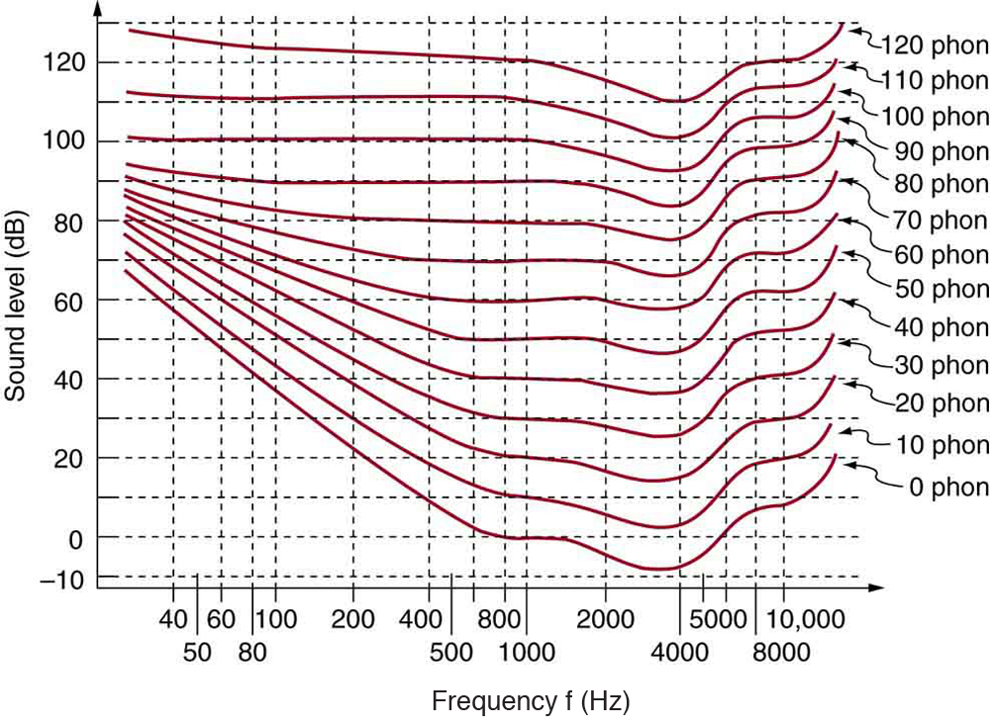
The relationship of loudness in phons to intensity level (in decibels) and intensity (in watts per meter squared) for persons with normal hearing. The curved lines are equal-loudness curves—all sounds on a given curve are perceived as equally loud. Phons and decibels are defined to be the same at 1000 Hz.
A unit called a phon is used to express loudness numerically. Phons differ from decibels because the phon is a unit of loudness perception, whereas the decibel is a unit of physical intensity. Figure shows the relationship of loudness to intensity (or
intensity level) and frequency for persons with normal hearing. The curved lines are equal-loudness curves. Each curve is labeled with its loudness in phons. Any sound along a given curve will be perceived as equally loud by the average person. The
curves were determined by having large numbers of people compare the loudness of sounds at different frequencies and sound intensity levels. At a frequency of 1000 Hz, phons are taken to be numerically equal to decibels. The following example helps illustrate how to use the graph:

Slide 25
Measuring Loudness: Loudness Versus Intensity Level and Frequency
(a) What is the loudness in phons of a 100-Hz sound that has an intensity level of 80 dB?
(1) Identify knowns:
• The square grid of the graph relating phons and decibels is a plot of intensity level versus frequency—both physical quantities.
• 100 Hz at 80 dB lies halfway between the curves marked 70 and 80 phons.
(2) Find the loudness: 75 phons.
(b) What is the intensity level in decibels of a 4000-Hz sound having a loudness of 70 phons?
(1) Identify knowns:
• Values are given to be 4000 Hz at 70 phons.
(2) Follow the 70-phon curve until it reaches 4000 Hz. At that point, it is below the 70 dB line at about 67 dB.
(3) Find the intensity level: 67 dB
(c) At what intensity level will an 8000-Hz sound have the same loudness as a 200-Hz sound at 60 dB?
(1) Locate the point for a 200 Hz and 60 dB sound.
(2) Find the loudness: This point lies just slightly above the 50-phon curve, and so its loudness is 51 phons.
(3) Look for the 51-phon level is at 8000 Hz: 63 dB.

Slide 26
Further examination of the graph in Figure 17.35 reveals some interesting facts about human hearing. First, sounds below the 0-phon curve are not perceived by most people. So, for example, a 60 Hz sound at 40 dB is inaudible. The 0-phon curve represents the threshold of normal hearing. We can hear some sounds at intensity levels below 0 dB. For example, a 3-dB, 5000-Hz sound is audible, because it lies above the 0-phon curve. The loudness curves all have dips in them between about 2000 and 5000 Hz. These dips mean the ear is most sensitive to frequencies in that range. For example, a 15-dB sound at 4000 Hz has a loudness of 20 phons, the same as a 20-dB sound at 1000 Hz. The curves rise at both extremes of the frequency range, indicating that a greater-intensity level sound is needed at those frequencies to be perceived to be as loud as at middle frequencies. For example, a sound at 10,000 Hz must have an intensity level of 30 dB to seem as loud as a 20 dB sound at 1000 Hz. Sounds above 120 phons are painful as well as damaging.

Slide 27
We do not often utilize our full range of hearing. This is particularly true for frequencies above 8000 Hz, which are rare in the environment and are unnecessary for understanding conversation or appreciating music. In fact, people who have lost the ability to hear such high frequencies are usually unaware of their loss until tested. The shaded region in Figure 17.36 is the frequency and intensity region where most conversational sounds fall. The curved lines indicate what effect hearing losses of 40 and 60 phons will have. A 40-phon hearing loss at all frequencies still allows a person to understand conversation, although it will seem
very quiet. A person with a 60-phon loss at all frequencies will hear only the lowest frequencies and will not be able to understand speech unless it is much louder than normal. Even so, speech may seem indistinct, because higher frequencies are not as well perceived. The conversational speech region also has a gender component, in that female voices are usually characterized by higher frequencies. So the person with a 60-phon hearing impediment might have difficulty understanding the normal conversation of a woman.

Slide 28
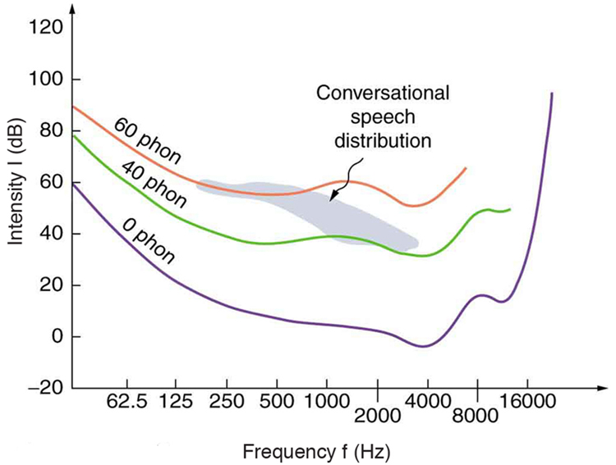
The shaded region represents frequencies and intensity levels found in normal conversational speech. The 0-phon line represents the normal hearing threshold, while those at 40 and 60 represent thresholds for people with 40- and 60-phon hearing losses, respectively.
Hearing tests are performed over a range of frequencies, usually from 250 to 8000 Hz, and can be displayed graphically in an audiogram like that in Figure. The hearing threshold is measured in dB relative to the normal threshold, so that normal
hearing registers as 0 dB at all frequencies. Hearing loss caused by noise typically shows a dip near the 4000 Hz frequency, irrespective of the frequency that caused the loss and often affects both ears. The most common form of hearing loss comes with age and is called presbycusis—literally elder ear. Such loss is increasingly severe at higher frequencies, and interferes with music appreciation and speech recognition.

Slide 29
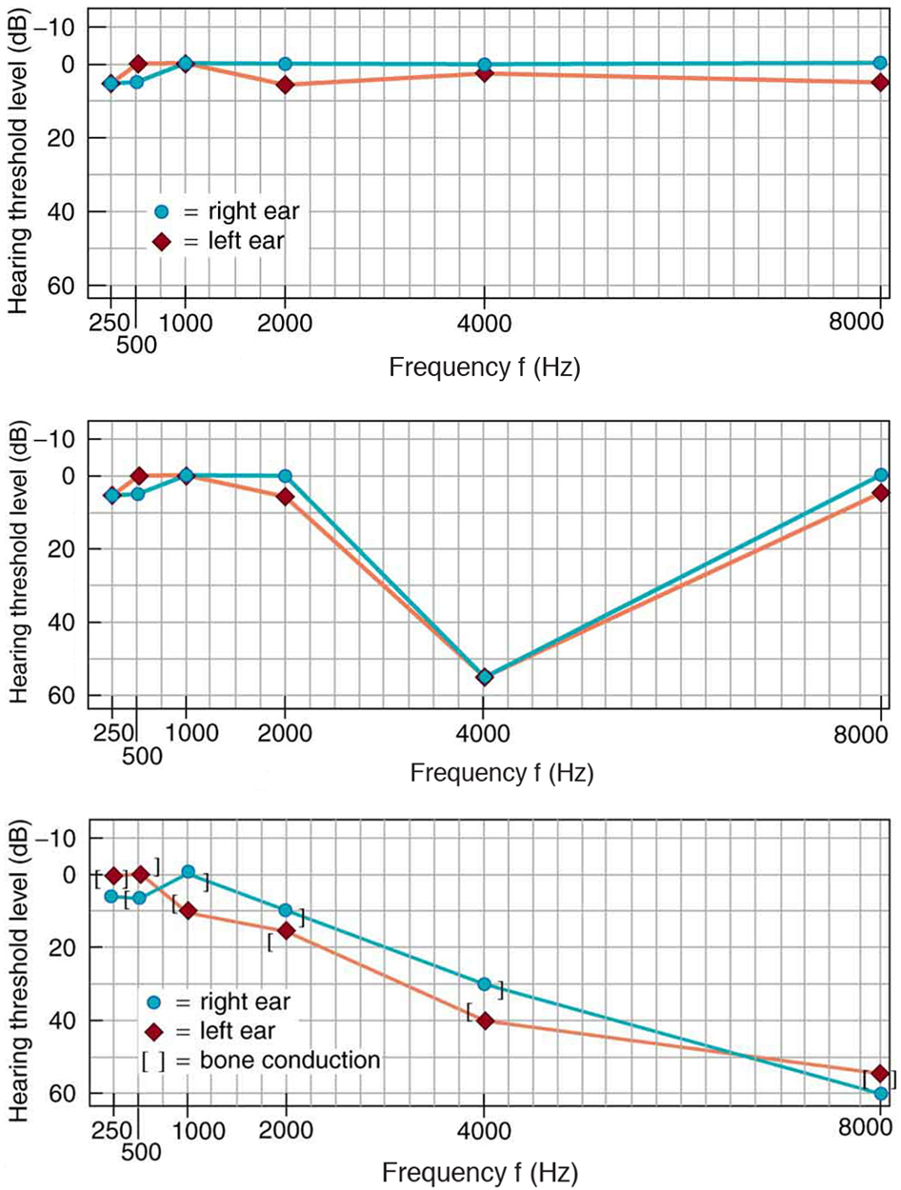
Audiograms showing the threshold in intensity level versus frequency for three different individuals. Intensity level is measured relative to the normal threshold. The top left graph is that of a person with normal hearing. The graph to its right has a dip at 4000 Hz and is that of a child who suffered hearing loss due to a cap gun. The third graph is typical of presbycusis, the progressive loss of higher frequency hearing with age. Tests performed by bone conduction (brackets) can distinguish nerve damage from middle ear damage.

Slide 30
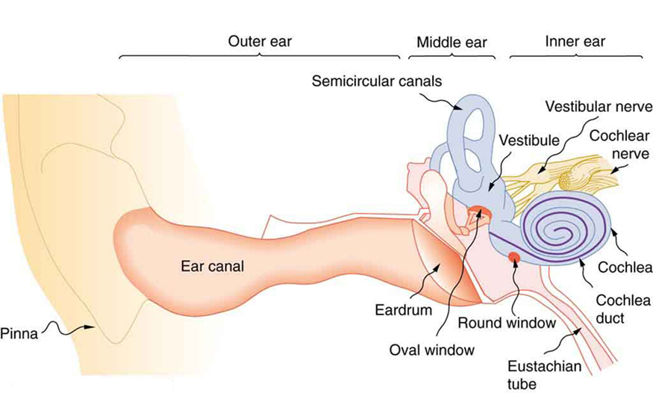
The illustration shows the gross anatomy of the human ear.
The Hearing Mechanism
The hearing mechanism involves some interesting physics. The sound wave that impinges upon our ear is a pressure wave. The ear is a transducer that converts sound waves into electrical nerve impulses in a manner much more sophisticated than, but analogous to, a microphone. Figure shows the gross anatomy of the ear with its division into three parts: the outer ear or ear canal; the middle ear, which runs from the eardrum to the cochlea; and the inner ear, which is the cochlea itself. The body part normally referred to as the ear is technically called the pinna.

Slide 31
The outer ear, or ear canal, carries sound to the recessed protected eardrum. The air column in the ear canal resonates and is partially responsible for the sensitivity of the ear to sounds in the 2000 to 5000 Hz range. The middle ear converts sound into
mechanical vibrations and applies these vibrations to the cochlea. The lever system of the middle ear takes the force exerted on the eardrum by sound pressure variations, amplifies it and transmits it to the inner ear via the oval window, creating pressure waves in the cochlea approximately 40 times greater than those impinging on the eardrum. (See Figure) Two muscles in the middle ear (not shown) protect the inner ear from very intense sounds. They react to intense sound in a few milliseconds and reduce the force transmitted to the cochlea. This protective reaction can also be triggered by your own voice, so that humming while shooting a gun, for example, can reduce noise damage.

Slide 32
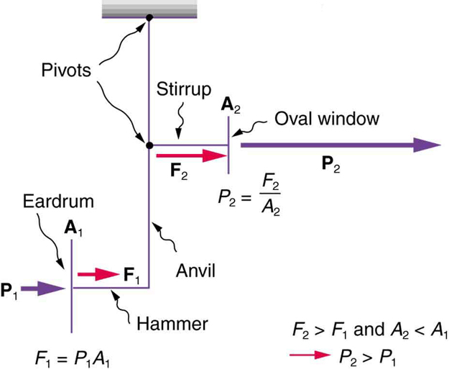
This schematic shows the middle ear’s system for converting sound pressure into force, increasing that force through a lever system, and applying the increased force to a small area of the cochlea, thereby creating a pressure about 40 times that in the original sound wave. A protective muscle reaction to intense sounds greatly reduces the mechanical advantage of the lever system.

Slide 33
Figure shows the middle and inner ear in greater detail. Pressure waves moving through the cochlea cause the tectorial membrane to vibrate, rubbing cilia (called hair cells), which stimulate nerves that send electrical signals to the brain. The membrane resonates at different positions for different frequencies, with high frequencies stimulating nerves at the near end and low frequencies at the far end. The complete operation of the cochlea is still not understood, but several mechanisms for sending information to the brain are known to be involved. For sounds below about 1000 Hz, the nerves send signals at the same frequency as the sound. For frequencies greater than about 1000 Hz, the nerves signal frequency by position. There is a structure to the cilia, and there are connections between nerve cells that perform signal processing before information is sent to the brain. Intensity information is partly indicated by the number of nerve signals and by volleys of signals. The brain processes the cochlear nerve signals to provide additional information such as source direction (based on time and intensity comparisons of sounds from both ears). Higher-level processing produces many nuances, such as music appreciation.

Slide 34
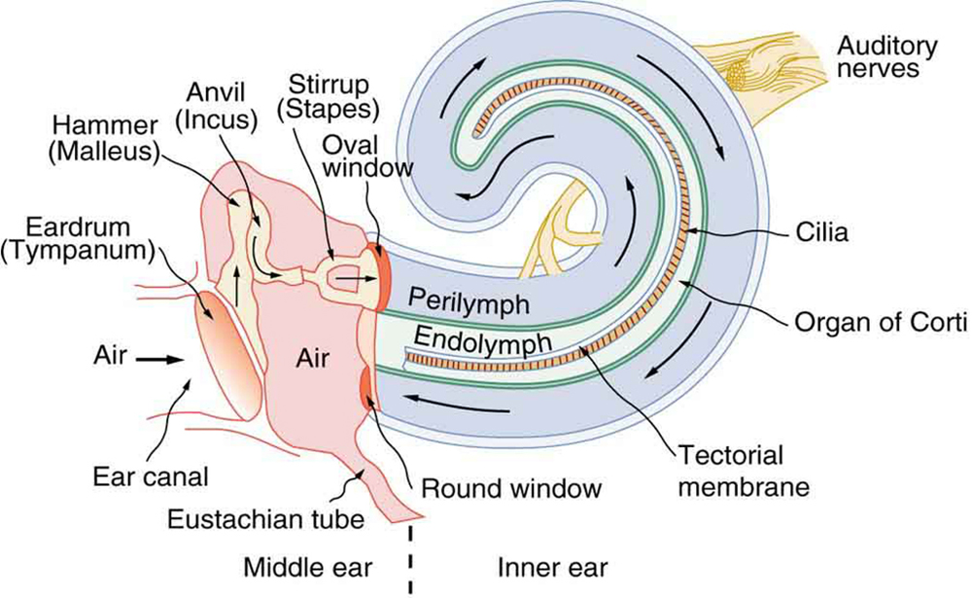
The inner ear, or cochlea, is a coiled tube about 3 mm in diameter and 3 cm in length if uncoiled. When the oval window is forced inward, as shown, a pressure wave travels through the perilymph in the direction of the arrows, stimulating nerves at the base of cilia in the organ of Corti.

Slide 35
Hearing losses can occur because of problems in the middle or inner ear. Conductive losses in the middle ear can be partially overcome by sending sound vibrations to the cochlea through the skull. Hearing aids for this purpose usually press against the bone behind the ear, rather than simply amplifying the sound sent into the ear canal as many hearing aids do. Damage to the nerves in the cochlea is not repairable, but amplification can partially compensate. There is a risk that amplification will produce further damage. Another common failure in the cochlea is damage or loss of the cilia but with nerves remaining functional. Cochlear implants that stimulate the nerves directly are now available and widely accepted. Over 100,000 implants are in use, in about equal numbers of adults and children.
The cochlear implant was pioneered in Melbourne, Australia, by Graeme Clark in the 1970s for his deaf father. The implant consists of three external components and two internal components. The external components are a microphone for picking up
sound and converting it into an electrical signal, a speech processor to select certain frequencies and a transmitter to transfer the signal to the internal components through electromagnetic induction. The internal components consist of a receiver/transmitter secured in the bone beneath the skin, which converts the signals into electric impulses and sends them through an internal cable to the cochlea and an array of about 24 electrodes wound through the cochlea. These electrodes in turn send the impulses directly into the brain. The electrodes basically emulate the cilia.

Slide 36
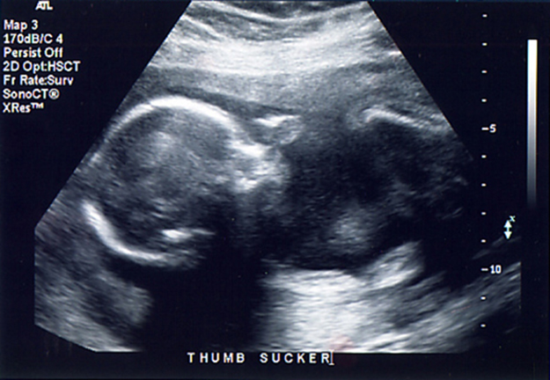
Ultrasound is used in medicine to painlessly and noninvasively monitor patient health and diagnose a wide range of disorders.
Any sound with a frequency above 20,000 Hz (or 20 kHz)—that is, above the highest audible frequency—is defined to be ultrasound. In practice, it is possible to create ultrasound frequencies up to more than a gigahertz. (Higher frequencies are
difficult to create; furthermore, they propagate poorly because they are very strongly absorbed.) Ultrasound has a tremendous number of applications, which range from burglar alarms to use in cleaning delicate objects to the guidance systems of bats. We begin our discussion of ultrasound with some of its applications in medicine, in which it is used extensively both for diagnosis and for therapy.

Slide 37
Characteristics of Ultrasound
The characteristics of ultrasound, such as frequency and intensity, are wave properties common to all types of waves. Ultrasound also has a wavelength that limits the fineness of detail it can detect. This characteristic is true of all waves. We
can never observe details significantly smaller than the wavelength of our probe; for example, we will never see individual atoms with visible light, because the atoms are so small compared with the wavelength of light.
Ultrasound in Medical Therapy
Ultrasound, like any wave, carries energy that can be absorbed by the medium carrying it, producing effects that vary with intensity. When focused to intensities of 10³ to 10⁵ W/m², ultrasound can be used to shatter gallstones or pulverize
cancerous tissue in surgical procedures. (See Figure) Intensities this great can damage individual cells, variously causing their protoplasm to stream inside them, altering their permeability, or rupturing their walls through cavitation. Cavitation is the
creation of vapor cavities in a fluid—the longitudinal vibrations in ultrasound alternatively compress and expand the medium, and at sufficient amplitudes the expansion separates molecules. Most cavitation damage is done when the cavities collapse, producing even greater shock pressures.

Slide 38
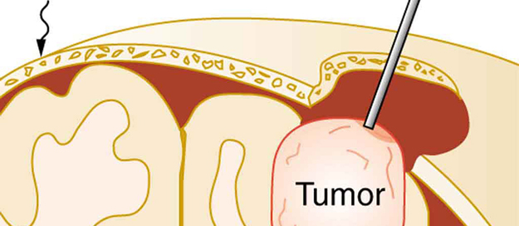
The tip of this small probe oscillates at 23 kHz with such a large amplitude that it pulverizes tissue on contact. The debris is then aspirated. The speed of the tip may exceed the speed of sound in tissue, thus creating shock waves and cavitation, rather than a smooth simple harmonic oscillator–type wave.
Most of the energy carried by high-intensity ultrasound in tissue is converted to thermal energy. In fact, intensities of 10³ to 10⁴ W/m² are commonly used for deep-heat treatments called ultrasound diathermy. Frequencies of 0.8 to 1 MHz are typical.
In both athletics and physical therapy, ultrasound diathermy is most often applied to injured or overworked muscles to relieve pain and improve flexibility. Skill is needed by the therapist to avoid “bone burns” and other tissue damage caused by
overheating and cavitation, sometimes made worse by reflection and focusing of the ultrasound by joint and bone tissue. In some instances, you may encounter a different decibel scale, called the sound pressure level, when ultrasound travels in
water or in human and other biological tissues. We shall not use the scale here, but it is notable that numbers for sound pressure levels range 60 to 70 dB higher than you would quote for β, the sound intensity level used in this text. Should you encounter a
sound pressure level of 220 decibels, then, it is not an astronomically high intensity, but equivalent to about 155 dB—high enough to destroy tissue, but not as unreasonably high as it might seem at first.

Slide 39
Ultrasound in Medical Diagnostics
When used for imaging, ultrasonic waves are emitted from a transducer, a crystal exhibiting the piezoelectric effect (the expansion and contraction of a substance when a voltage is applied across it, causing a vibration of the crystal). These high frequency
vibrations are transmitted into any tissue in contact with the transducer. Similarly, if a pressure is applied to the crystal (in the form of a wave reflected off tissue layers), a voltage is produced which can be recorded. The crystal therefore acts as both
a transmitter and a receiver of sound. Ultrasound is also partially absorbed by tissue on its path, both on its journey away from the transducer and on its return journey. From the time between when the original signal is sent and when the reflections from
various boundaries between media are received, (as well as a measure of the intensity loss of the signal), the nature and position of each boundary between tissues and organs may be deduced. Reflections at boundaries between two different media occur because of differences in a characteristic known as the acoustic impedance Z of each substance. Impedance is defined as
Z = ρv
where ρ is the density of the medium (in kg/m³) and v is the speed of sound through the medium (in m/s). The units for Z are therefore kg/(m²·s). Table shows the density and speed of sound through various media (including various soft tissues) and the associated acoustic impedances. Note that the acoustic impedances for soft tissue do not vary much but that there is a big difference between the acoustic impedance of soft tissue and air and also between soft tissue and bone.

Slide 40
The Ultrasound Properties of Various Media, Including Soft Tissue Found in the Body
Medium Density (kg/m³) Speed of Ultrasound (m/s) Acoustic Impedance(kg/m²⋅s)
Air 1.3 330 429
Water 1000 1500 1.5×10⁶
Blood 1060 1570 1.66×10⁶
Fat 925 1450 1.34×10⁶
Muscle 1075 1590 1.70×10⁶
Bone 1400–1900 4080 5.7×10⁶ to 7.8×10⁶
BaTiO₃ 5600 5500 30.8×10⁶
At the boundary between media of different acoustic impedances, some of the wave energy is reflected and some is transmitted.
The greater the difference in acoustic impedance between the two media, the greater the reflection and the smaller the transmission.

Slide 41
The intensity reflection coefficient a is defined as the ratio of the intensity of the reflected wave relative to the incident (transmitted) wave. This statement can be written mathematically as
a = (Z₂ − Z₁)²/(Z₁ + Z₂)²
where Z₁ and Z₂ are the acoustic impedances of the two media making up the boundary. A reflection coefficient of zero (corresponding to total transmission and no reflection) occurs when the acoustic impedances of the two media are the same. An impedance “match” (no reflection) provides an efficient coupling of sound energy from one medium to another. The image formed in an ultrasound is made by tracking reflections (as shown in Figure 17.43) and mapping the intensity of the reflected sound waves in a two-dimensional plane.

Slide 42
Calculate Acoustic Impedance and Intensity Reflection Coefficient: Ultrasound and Fat Tissue
(a) Using the values for density and the speed of ultrasound given in Table 17.5, show that the acoustic impedance of fat tissue is indeed 1.34×10⁶ kg/(m² ·s) .
(1) Substitute known values from Table 17.5 into Z = ρv .
Z = ρv = 925 kg/m³ (1450 m/s)
(2) Calculate to find the acoustic impedance of fat tissue.
1.34×10⁶ kg/(m² ·s)
This value is the same as the value given for the acoustic impedance of fat tissue.
(b) Calculate the intensity reflection coefficient of ultrasound when going from fat to muscle tissue.

Slide 43
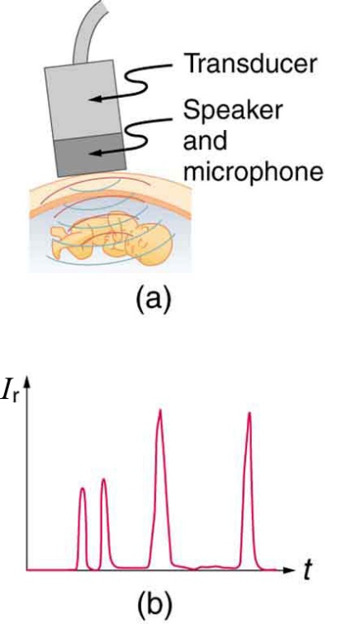
An ultrasound speaker doubles as a microphone. Brief bleeps are broadcast, and echoes are recorded from various depths.
Graph of echo intensity versus time. The time for echoes to return is directly proportional to the distance of the reflector, yielding this information noninvasively.
The applications of ultrasound in medical diagnostics have produced untold benefits with no known risks. Diagnostic intensities are too low (about 10⁻² W/m² ) to cause thermal damage. More significantly, ultrasound has been in use for several decades and detailed follow-up studies do not show evidence of ill effects, quite unlike the case for x-rays.

